Slide 1
EQUIPMENT MANAGEMENT
Presentor: Nguyen Lam Hoang Anh
1

Slide 2
CONTENTS
REQUIREMENTS
SYSTEM SPECIFICATION
DEMO
OVERVIEW
2

Slide 3
REQUIREMENTS
1
2
Functional requirements
Non-functional requirements
3

Slide 4
Funtional requirements
Manage all equipment of company
Add, edit, assign, remove and view equipment
List user's assinged equipment.
Equipment can be assign to one or no user
Authenticate and authorize user.
Error handling and data validation.
4

Slide 5
Non - functional requirements
User interface need to be simple and easy to use
Extensibility.
5

Slide 6
SYSTEM SPECIFICATION
1
2
3
4
5
Technologies
System architecture
Database design
Features
Laravel concepts
6

Slide 7





Technologies
Front-end
Back-end
7

Slide 8
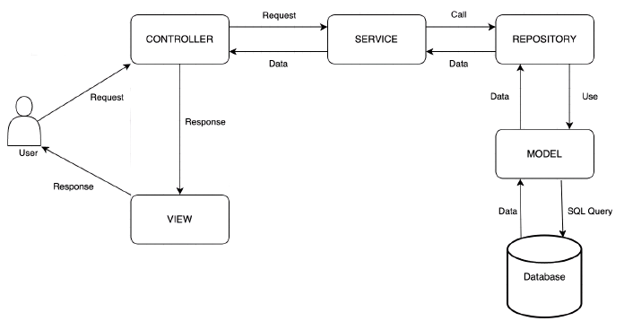
System architecture
Service layer: handling bussiness logic
Repository layer: using model to interact with database
8

Slide 9
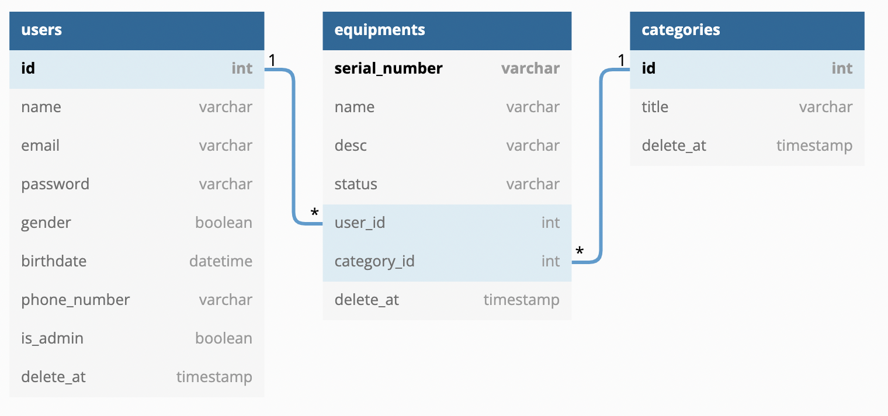
Database design
9

Slide 10
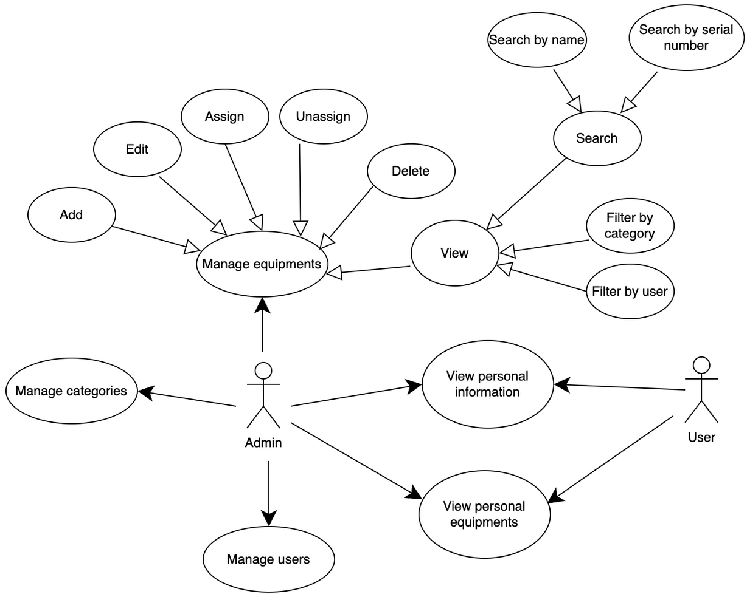
Features
10

Slide 11
Laravel concepts
Routing: Web route, API route
Controller
Eloquent ORM
Migration
Middleware
JWT (JSON web token)
Eloquent resources
11

Slide 12
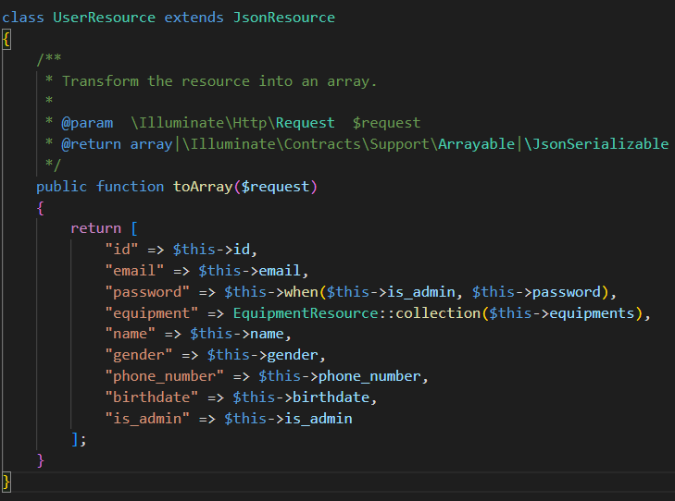
Eloquent resource
UserResource class
12

Slide 13
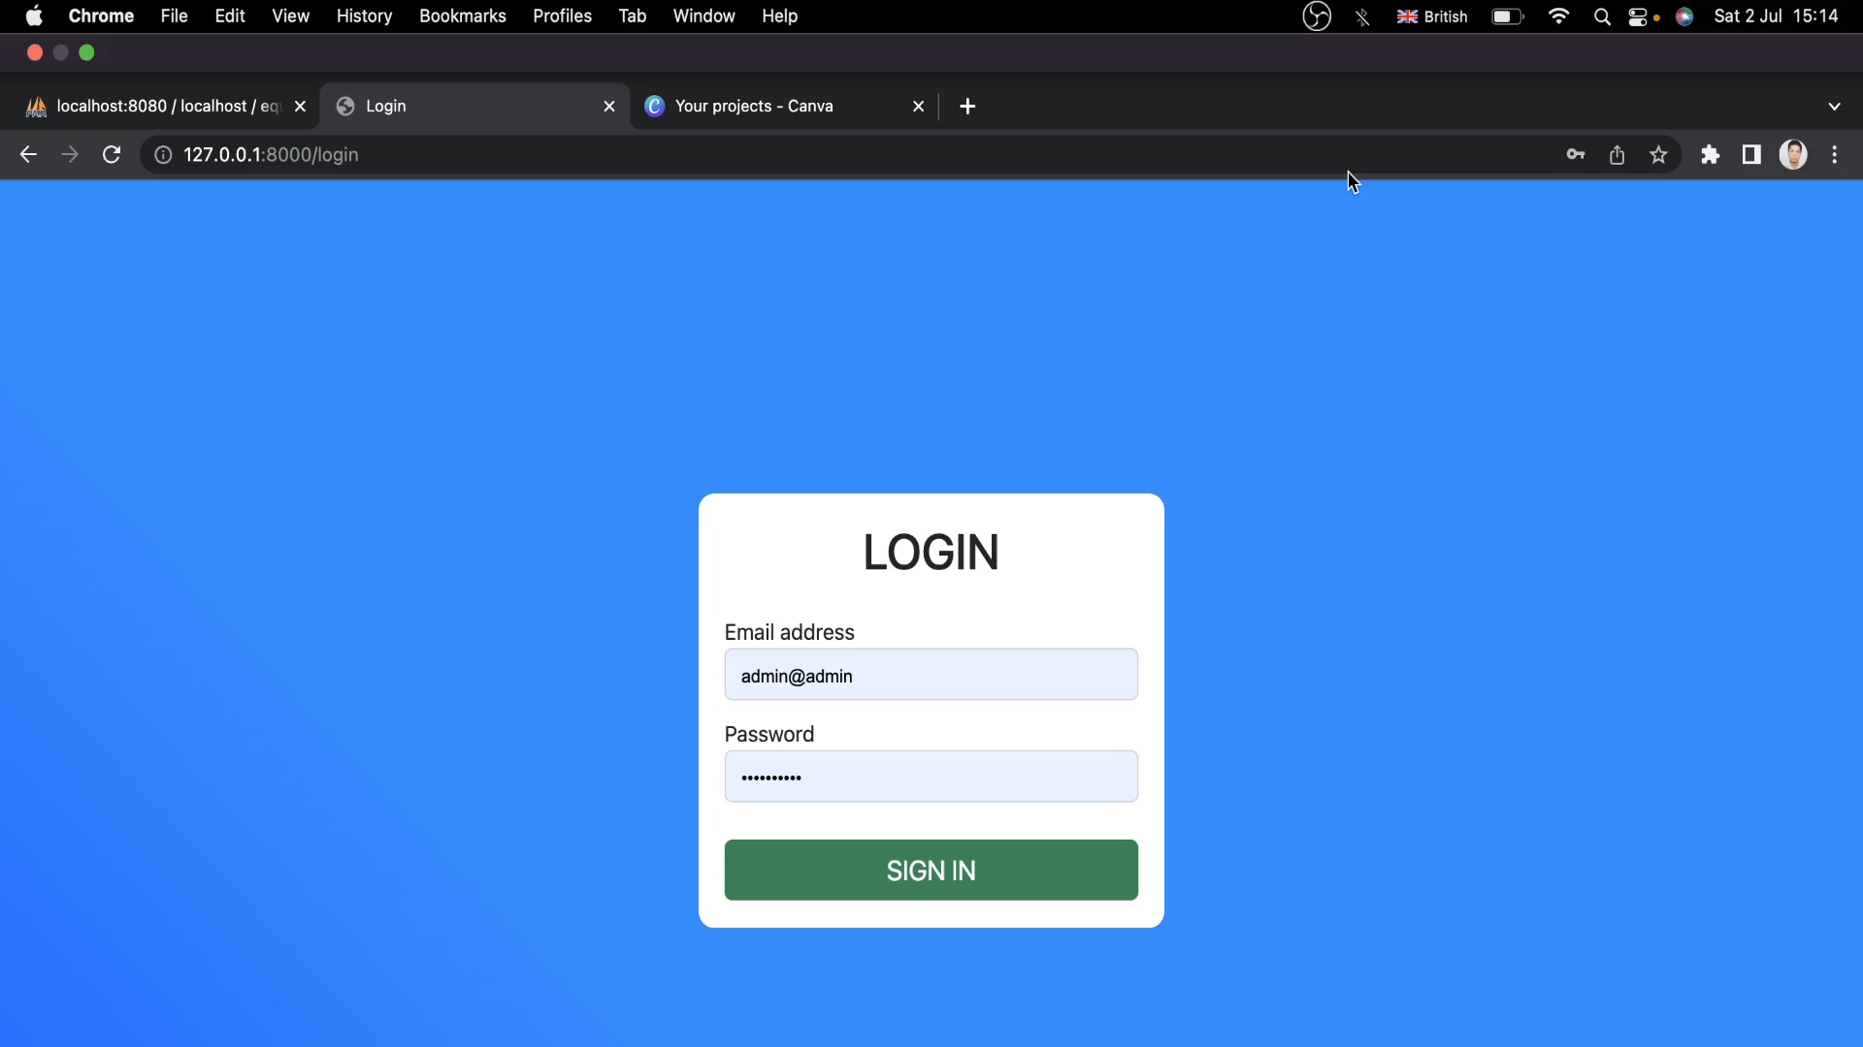
DEMO
13

Slide 14
OVERVIEW
1
2
3
Advantages
Disavantages
Future improvements
14

Slide 15
Advantages
Manage equipments easily with simple user interface.
Listing equipment by user name or id.
15

Slide 16
Disadvantages
Admin may accidentally press unassigned button.
Normal user can not request for equipments.
User can not update their information.
16

Slide 17
Future improvements
Implement missing features in disadvantages section.
Add new features for upload equipment’s images.
17

Slide 18

18

Slide 19

19

